Slide 1
mCLASS/DIBELS
Interim Assessment Team

Slide 2
Session Items
mCLASS/DIBELS overview
Login
Required Assessments
Administration
Scoring Rules
Gating Rules
Composite Score

Slide 3
Transitioning Platforms
Making Way for mCLASS/DIBELS HISD’s Dyslexia Screener (K-1)

Slide 4
Purpose
To access a thorough knowledge/understanding of students’ development towards reading proficiency.

Slide 5
Window Dates
BOY: September 18th – October 20th
MOY: January 10th – January 31st (1st Grade)
January 10th – February 13th (Kindergarten)
EOY: April 14th – May 10th
*As of 8/31/2023

Slide 6
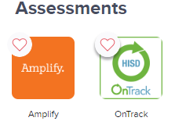
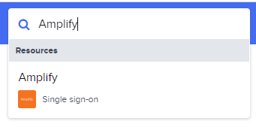
How to Login
Teachers should have accounts set up in Clever.
Locate the Amplify icon under Assessments
Use the search box to find Amplify
If Amplify does not appear, contact servicedesk@houstonisd.org

Slide 7
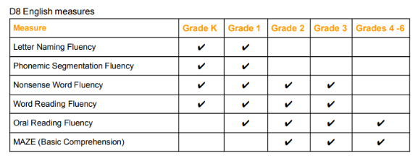
Required Measures

Slide 8
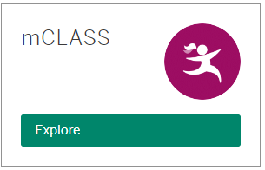
Accessing Student Materials
4
1
3
5
2

Slide 9
Gating Rules
There are two ways that gating rules work:
By discontinuing benchmark assessment for low-performing students.
By “testing out” high performing students.

Slide 10
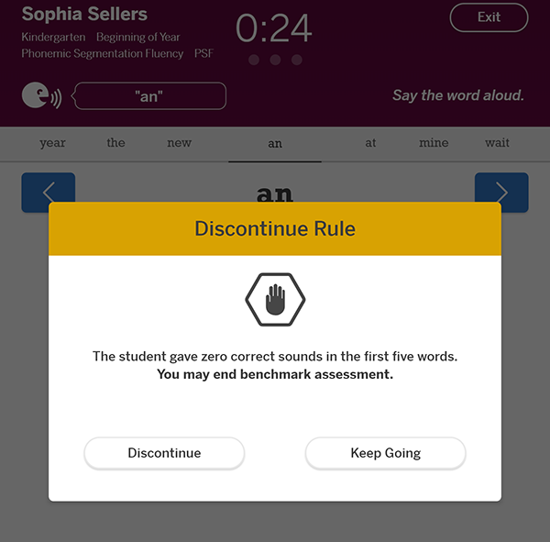
Discontinue Rules
Each subtest has a discontinue rule called the "discontinue measure rule" that triggers if a student gives zero correct answers within the first few responses of the assessment (the threshold varies by measure). When the discontinue rule is triggered, a popup prompts you stop assessing the measure.

Slide 11
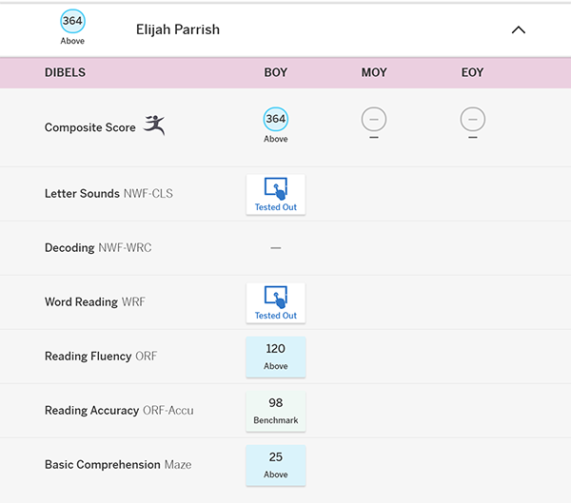
Test-Out
Some measures have a test-out rule that triggers when a student scores above the benchmark cut-score, and any other required measures are "tested-out".
The student in this example is a Grade 2 student who has triggered the test-out rule for ORF. The NWF and WRF measures display Tested-Out icons:

Slide 12
Measure Icons Key
Blue = required
White = optional
Faded Out = gated

Slide 13
Composite Score Benchmarks
English scores
Grade | Time of Year | Student Score | Performance Descriptor
Kindergarten | BOY | 200-279 | Well Below Benchmark (Red)
 |  | 280-305 | Below Benchmark (Yellow)
 |  | 306-331 | At Benchmark (Green)
 |  | 332+ | Above Benchmark (Blue)
 | MOY | 200-355 | Well Below Benchmark (Red)
 |  | 356-370 | Below Benchmark (Yellow)
 |  | 371-392 | At Benchmark (Green)
 |  | 393+ | Above Benchmark (Blue)
 | EOY | 200-405 | Well Below Benchmark (Red)
 |  | 406-419 | Below Benchmark (Yellow)
 |  | 420-449 | At Benchmark (Green)
 |  | 450+ | Above Benchmark (Blue)
Grade | Time of Year | Student Score | Performance Descriptor
1st Grade | BOY | 200-320 | Well Below Benchmark (Red)
 |  | 321-329 | Below Benchmark (Yellow)
 |  | 330-353 | At Benchmark (Green)
 |  | 354+ | Above Benchmark (Blue)
 | MOY | 200-376 | Well Below Benchmark (Red)
 |  | 377-388 | Below Benchmark (Yellow)
 |  | 389-423 | At Benchmark (Green)
 |  | 424+ | Above Benchmark (Blue)
 | EOY | 200-426 | Well Below Benchmark (Red)
 |  | 427-440 | Below Benchmark (Yellow)
 |  | 441-479 | At Benchmark (Green)
 |  | 480+ | Above Benchmark (Blue)

Slide 14
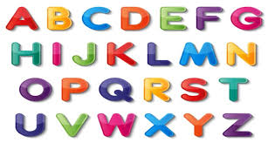
Letter Naming Fluency (LNF)
The student is presented with a page of uppercase and lowercase letters and asked to name the letters. (Grades K-1)
Scoring Rules
LNF Administration

Slide 15
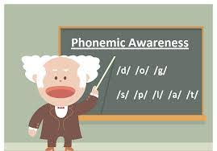
Phonemic Segmentation Fluency (PSF)
The assessor says words, and the student says the individual sounds for each word. (Grades K-1)
Scoring Rules
PSF Administration

Slide 16
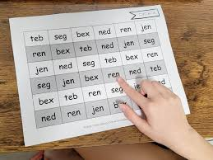
Nonsense Word Fluency (NWF)
The student is presented with a list of VC and CVC nonsense words (e.g., sig, rav, ov) and asked to read the words. (Grades K-3)
Scoring Rules
NWF Administration

Slide 17
Word Reading Fluency (WRF)
The student is presented with a page of words and asked to read as many words as possible within 1 minute. (Grades K-3)
Scoring Rules
WRF Administration

Slide 18
Oral Reading Fluency (ORF)
The student is presented with a reading passage and asked to read aloud. (Grades 1-4)
Scoring Rules
ORF Administration

Slide 19
Maze
The student is presented with a reading passage where some words are replaced by a multiple-choice box that includes the original word and two distractors. (Grades 2-4)
MAZE Scoring Rules
MAZE Administration

Slide 20
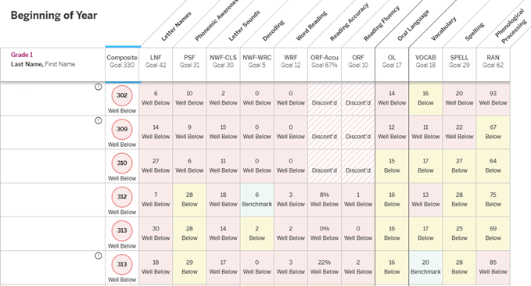
Reports: Dyslexia Flagging
The “!” icon indicates flagging for dyslexia. This is determined by the Composite Score and Spelling components.

Slide 21
Resources
Canvas Course: https://canvas.houstonisd.org/enroll/LTELWY
Student Assessment Webpage
Amplify PD Library
mClass Scoring Rules Summary Table:

Slide 22
Student Assessment Support
Email: Book 1 on 1 Support​
assessment@houstonisd.org

Slide 23
Thank you
Date: 09/xx/2023
Presenter: First and last name
Title

